Slide 1

Team Name : MARUTI
Team Leader Name : JAYDEEP GHOSH
Problem Statement : Personalized Career and Skills Advisor

Slide 2
Brief about the prototype:
Our prototype is an AI-powered Career Consultancy Platform that helps students after completing their 12th standard choose the best study line (Engineering, Medical, Commerce, Arts, Vocational, etc.).
It works like a virtual counselor by analyzing:
Academic background (stream + subjects)
Personal interests & passions
Career goals
Skill requirements & market demand
The system then recommends the most suitable branch with a percentage match, along with a learning path, required skills, entrance exams, top colleges, and career roadmap. This ensures students make well-informed decisions aligned with both their interests and future job opportunities.

Slide 3
Opportunity should be able to explain the following:
How different is it from any of the other existing solutions?
Current career counseling is either manual (offline, costly) or generic (same advice for everyone).
Our solution is:
AI-driven personalization → recommendations unique to each student.
Stream–interest–goal compatibility check → eliminates mismatched suggestions.
Localized support → helps Tier 2/3 students access structured guidance.
USP of the proposed solution
How will it be able to solve the problem?
End-to-end journey: From 12th stream → branch selection → career goal alignment → skill/college roadmap.
Verification layer: Mobile + document upload for authenticity.
Gamified learning path with quizzes to verify understanding.
Future expansion: AI-based mentor chatbot, local language support, and integration with job portals.
Identifies a student’s aptitude & passion.
Maps it to stream compatibility & future goals.
Recommends a best-fit branch with a success percentage score.
Provides a learning path + skill roadmap to achieve the goal.

Slide 4
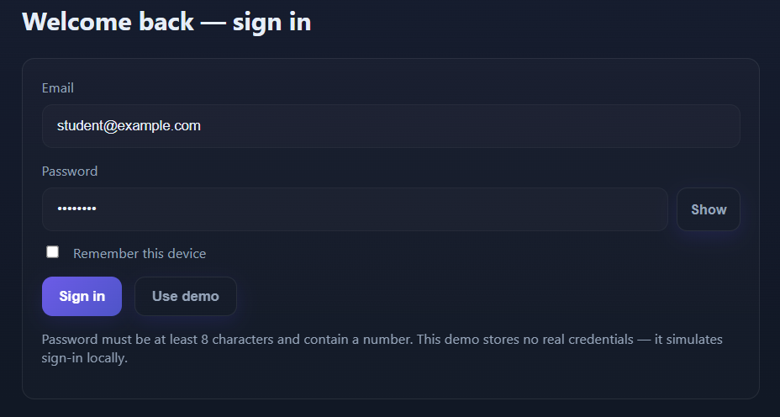
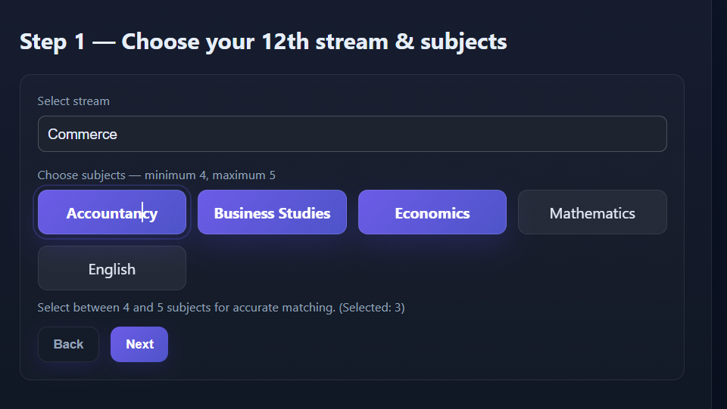
List of features offered by the solution:
Login & profile creation with verification.
Stream and subject selection

Slide 5
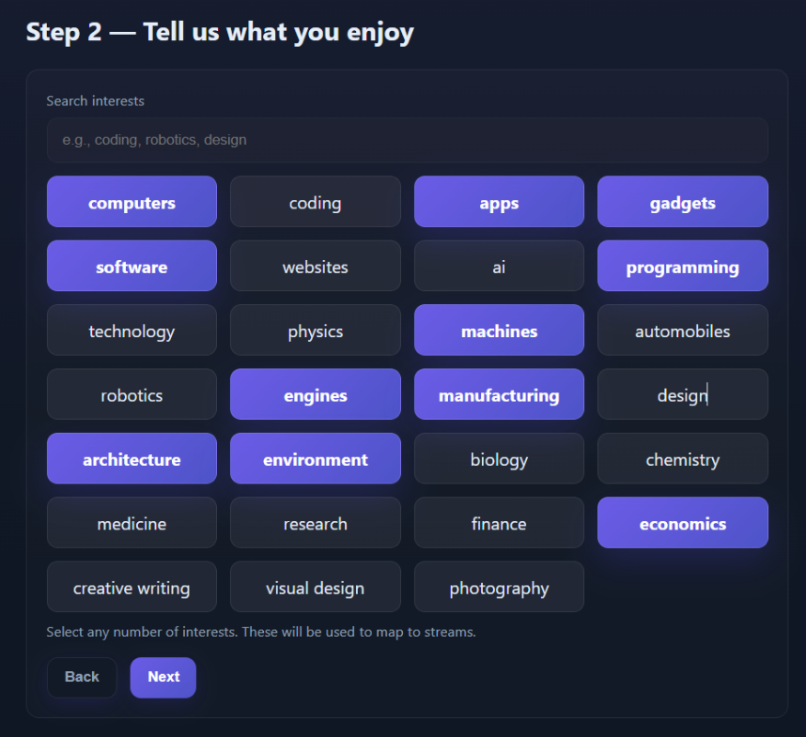
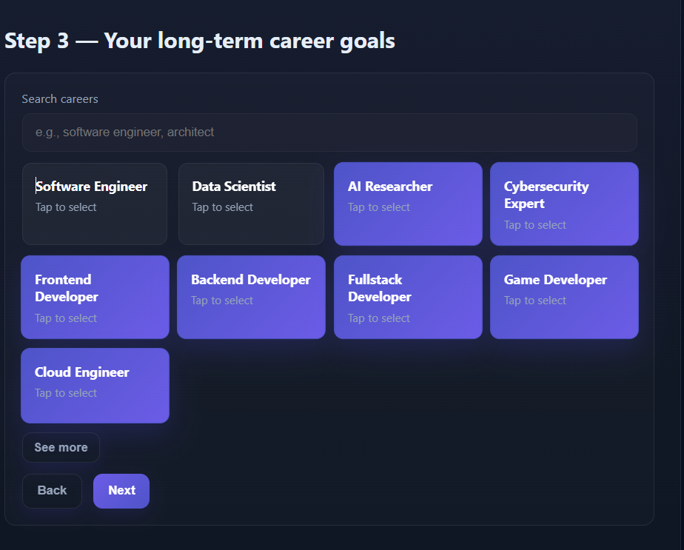
Passion & interest mapping.
Career goal selection.

Slide 6
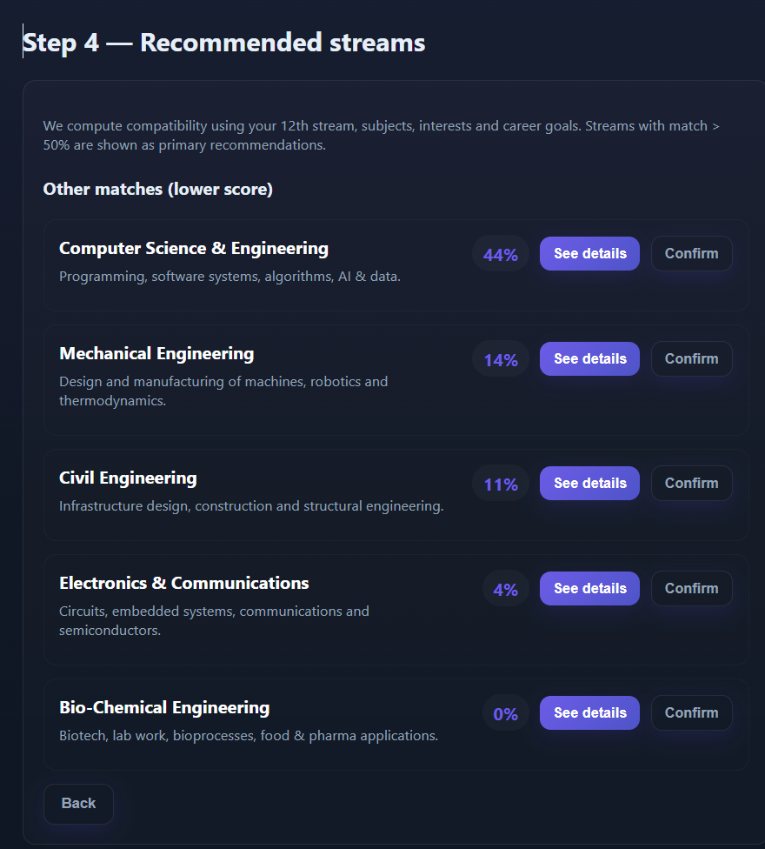
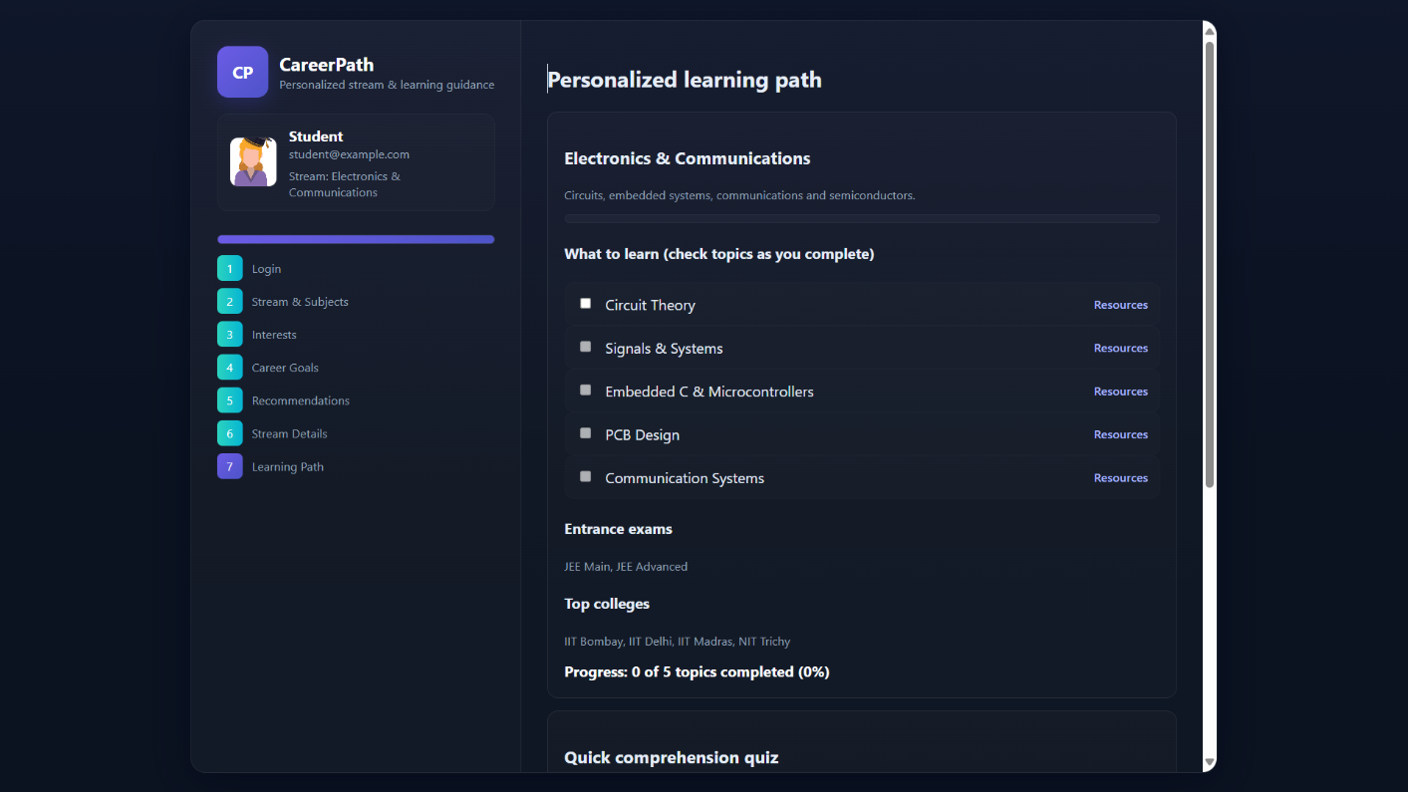
AI-powered best branch recommendation with % match.
Detailed learning path (skills, exams, top colleges).
Quiz-based validation for better understanding.
Progress dashboard with next steps.

Slide 7
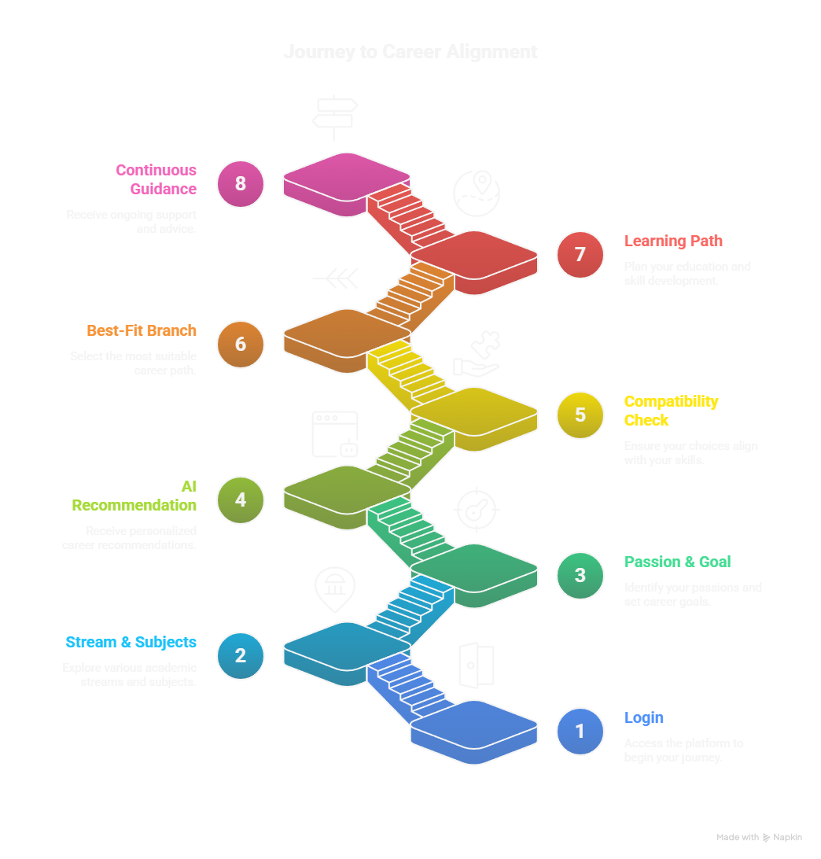
Process flow diagram or Use-case diagram:

Slide 8
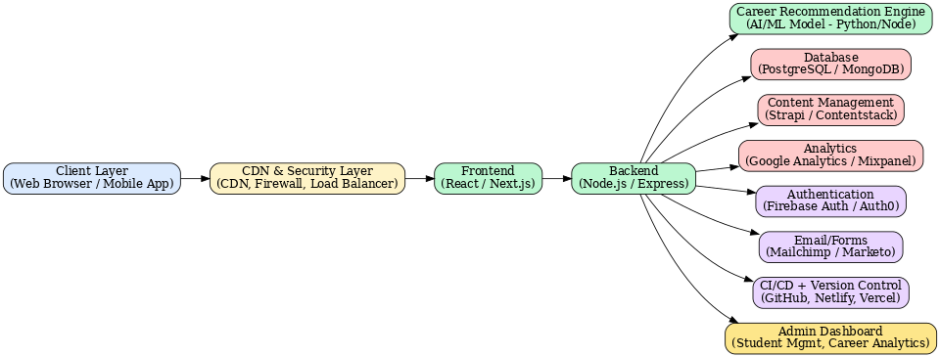
Architecture diagram of the proposed solution:

Slide 9
Technologies to be used in the solution:
Frontend: HTML, CSS, JavaScript (Future: React)
Backend: Node.js, Express, Firebase
AI/ML: Python (TensorFlow, Scikit-learn), NLP
Database: PostgreSQL, Firebase
Deployment: AWS, GitHub, Figma
Future Integrations: College & Exam APIs, Coursera

Slide 10
Problem :
Students face difficulty in selecting the right stream, subjects, and career path.
Lack of personalized, structured, and data-driven guidance.
Context / Approach:
Built an AI-powered career guidance prototype.
Web app with Login → Stream & Subject Selection → Interests → Career Goals → AI Recommendations → Personalized Learning Path.
Designed a scalable system architecture with Frontend, Backend, AI/ML, and Database layers.
Results:
Working prototype website with:
Stream selection
Career goals & interests mapping
AI-powered recommendations
Personalized learning path with quizzes & progress tracking
Architecture diagram created for future scalability.
Future scope identified: Mobile app, real college/exam integration, advanced AI advisor.

Slide 11

Google Cloud
i iżs

